Slide 1

NBA Honors Selections
Almona & Vedant

Slide 2
What is the nba?
The National Basketball Association (NBA) is a professional basketball league in North America with 30 teams.
The teams are divided into two conferences (west and east), playing 82 games in the regular season.
At the end of each regular season, players may receive honors such as All-NBA, All-Defensive, and All-Rookie Team selections.

Slide 3
Research Question
Can we predict NBA honors using regular season
box score statistics?

Slide 4
Why this project matters
All-NBA honors influence supermax contract eligibility.
Recognition impacts player value and sports betting markets.
Understanding selection patterns can assist in front office decisions and analytics.

Slide 5
Data source
Source: Kaggle dataset by Sumitro Datta
https://www.kaggle.com/datasets/sumitrodatta/nba-aba-baa-stats
Scope: Includes NBA from 1947 - present, but we filtered for 2016-17 until 2023-24 excluding 2019-20 & 2020-21

Slide 6
Data source
Variables:
Games played (g), games started (gs), minutes played (mp), points per 100 possessions, assists, rebounds, steals, blocks, fouls, etc.
Why per 100 possessions stats (over per game or per 36 minutes)?
Controls for pace and playing time.
More standardized measure of efficiency across different eras and teams.

Slide 7
Data summary
Eligibility Criteria:
All-NBA/All-Defense: (as of 2023)
g >= 65 and mp >= 20 mins per game (except two games)
All-Rookie: experience == 1

Slide 8
Data summary
Descriptive Statistics:
Correlation matrix to explore relationships.
Players with more minutes, points, and efficiency tend to receive honors.

Slide 9
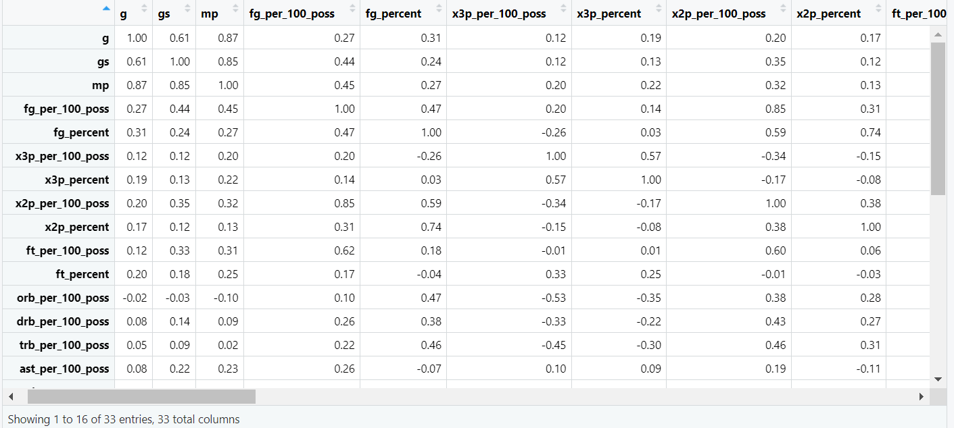
Data summary

Slide 10
Modeling overview
Approach:
Logistic regression (GLM) for binary outcomes.
Stepwise selection.
Best subset regression using Cp criterion.

Slide 11
Modeling overview
Separate Models Built For:
All-NBA
All-Defense
All-Rookie

Slide 12
All-NBA Model
 | estimate | p-value
(intercept) | -2.43 | 3.85 x 10⁻¹²
mp | 1.84 x 10⁻³ | 0.000515
x3p_per_100_poss | 2.50 x 10⁻¹ | 0.0955
x2p_per_100_poss | 1.87 x 10⁻¹ | 0.0641
x2p_percent | 6.92 | 0.0378
ft_percent | 10.7 | 0.000294
trb_per_100_poss | 1.23 x 10⁻¹ | 0.0376
ast_per_100_poss | 1.48 x 10⁻¹ | 0.0128
blk_per_100_poss | 4.91 x 10⁻¹ | 0.0406
shooting_foul_committed | -3.15 x 10⁻² | 0.00265
shooting_foul_drawn | 9.74 x 10⁻³ | 0.00588
playoffs | 1.87 | 0.000277

Slide 13
All-nba model
Since 2-point scored and 2-point % are in the model, we tested whether or not adding an interaction between these terms would improve the model.
H₀ : The interaction term does not significantly improve prediction of All-NBA selection.
H_{A} : The interaction term significantly improves prediction of All-NBA selection.
> anova(test1, test2)
Output: p-value is 0.855, which is very high, so we fail to reject the null.
✅ So: adding the interaction does not significantly improve the model's fit.

Slide 14
All-Defense Model
 | estimate | p-value
(intercept) | 9.90 | 3.85 x 10⁻¹²
gs | 0.055 | 4.31 x 10⁻⁵
posPF | -21.52 | 6.00 x 10⁻⁶
posPG | -17.09 | 0.000121
posSF | -14.60 | 0.000157
posSG | -18.66 | 1.06 x 10⁻⁵
drb_per_100_poss | -0.80 | 0.003364
stl_per_100_poss | 1.47 | 1.68 x 10⁻⁷
pf_per_100_poss | -2.12 | 0.00110
posPF:drb_per_100_poss | 1.06 | 0.000225
posSG:blk_per_100_poss | 3.83 | 0.00141
posSF:pf_per_100_poss | 2.16 | 0.0931
drb_per_100_poss:blk_per_100_poss | 0.44 | 0.000109
Other interactions: blk_per_100_poss*shooting_foul_committed, blk_per_100_poss*offensive_foul_drawn

Slide 15
All-rookie Model
 | estimate | p-value
(intercept) | -6.85 | 1.33 x 10⁻¹⁰
mp | 0.00168 | 2.74 x 10⁻¹¹
fg_per_100_poss | 0.280 | 0.00150
playoffs | 0.821 | 0.0365
blk_per_100_poss | 1.88 | 0.00737
pf_per_100_poss | 0.0538 | 0.748
blk_per_100_poss:pf_per_100_poss | -0.290 | 0.0311
Insights:
Minutes and scoring per 100 possessions are strong indicators.
Rookies who contribute defensively and avoid fouling are more likely to be selected.

Slide 16
All-rookie model
Main Term: pf_per_100_poss
Estimate: +0.054; p-value: 0.748 (not statistically significant)
Interpretation: When blk_per_100_poss = 0, an increase in personal fouls per 100 possessions is associated with a slight increase in the odds of making All-Rookie — but this effect is statistically meaningless on its own.
Interaction Term: blk_per_100_poss:pf_per_100_poss
Estimate: -0.290; p-value: 0.031 (statistically significant)
Interpretation: The positive effect of blocks on All-Rookie odds decreases as personal fouls increase. In other words:
"Blocks are good, but not if you're fouling a lot."
This suggests that efficiency matters — rookies who can block shots without fouling are more likely to be rewarded.

Slide 17
2025 Season predictions: ALl-nba
Player Name
Team
%Prob
Player Name
Team
%Prob
Player Name
Team
%Prob
Nikola Jokić
DEN
85.65
Tyler Herro
MIA
65.72
Tyrese Haliburton
IND
38.02
Shai Gilgeous-Alexander
OKC
81.33
LeBron James
LAL
64.86
Karl-Anthony Towns
NYK
23.88
Giannis Antetokounmpo
MIL
78.93
Anthony Edwards
MIN
63.18
Jalen Brunson
NYK
22.54
James Harden
LAC
65.79
Stephen Curry
GSW
45.15
Darius Garland
CLE
19.85
Jayson Tatum
BOS
65.53
Cade Cunningham
DET
39.17
Austin Reaves
LAL
17.68
MVP Finalists

Slide 18
2025 Season predictions: ALl-defense
Player Name
Team
%Prob
Player Name
Team
%Prob
Toumani Camara
POR
96.40
Evan Mobley
CLE
50.61
Dyson Daniels
ATL
80.41
Nikola Jokić
DEN
44.00
Derrick White
BOS
60.00
Draymond Green
GSW
39.42
Bam Adebayo
MIA
58.95
Giannis Antetokounmpo
MIL
34.65
Jalen Williams
OKC
51.43
Jarrett Allen
CLE
32.35
Defensive Player Of the Year Finalists

Slide 19
2025 Season predictions: ALl-rookie
Player Name
Position
Team
%Prob
Player Name
Position
Team
%Prob
Kel'el Ware
C
MIA
72.50
Zaccharie Risacher
SF
ATL
42.61
Alex Sarr
C
WAS
69.27
Jaylen Wells
SG
MEM
39.85
Yves Missi
C
NOP
62.72
Branden Carlson
C
OKC
39.49
Stephon Castle
PG
SAS
51.19
Bub Carrington
PG
WAS
36.11
Matas Buzelis
SF
CHI
43.80
Zach Edey
C
MEM
34.76
Rookie Of the Year Finalists

Slide 20
OUTCOME: ALl-rookie announced Tuesday, May 20 @2pm ET
Player Name
Position
Team
%Prob
Est. Rank
Stephon Castle
PG
SAS
51.19
4
Zach Edey
C
MEM
34.76
10
Zaccharie Risacher
SF
ATL
42.61
6
1st-Team
Alex Sarr
C
WAS
69.27
2
Jaylen Wells
SG
MEM
39.85
7
Matas Buzelis
SF
CHI
43.80
5
Bub Carrington
PG
WAS
36.11
9
2nd-Team
Donovan Clingan
C
POR
5.34
43
Yves Missi
C
NOP
62.72
3
Rookie of the Year Winner
Kel'el Ware
C
MIA
72.50
1
Did not make our Top-10
*Branden Carlson, ranked 8th in our model, did not make the team

Slide 21
Limitations & assumptions
Limitations:
No advanced metrics (e.g., BPM, RAPTOR)
Voter biases
Some player/team context omitted (e.g., team record, media coverage)
Assumptions:
Selection criteria consistent across years
Variables accurately reported and standardized

Slide 22
Conclusion
Summary:
Logistic regression can reasonably predict honors selections.
Defensive selections more complex due to interactions.
Rookie selection influenced by playing time and efficiency.
Implications:
Teams can use this to identify rising stars or undervalued contributors.
Sports media and bettors may apply similar models.

Slide 23
Thank you. QA?

